Slide 1
Syringe
Static Pressure Input
Air Density Input
A/C Weight Input
Vertical Acceleration Input
Flap Position Input
SparkFun Qwiic MicroPressure Sensor
Raspberry Pi Module 1
Raspberry Pi Module 2
Overspeed LED
Airspeed Display
Vertical Acceleration LED
Excessive Manoeuvre LED
VAC Limit Display (Optional)

Slide 2
Syringe
Test Case Laptop/Tablet
SparkFun Qwiic MicroPressure Sensor
Test Case Laptop/Tablet
Student Tablets
Raspberry Pi Module 1
Raspberry Pi Module 2
Overspeed LED
Airspeed Display
Vertical Acceleration LED
Excessive Manoeuvre LED
VAC Limit Display (Optional)

Slide 3
Read I²C Output (Adafruit_MPRLS Library, readPressure function, returns float in HPA by default)
Syringe
Test Case Laptop/Tablet
1
SparkFun Qwiic MicroPressure Sensor
Test Case Laptop/Tablet
2
Receive commands/code
Student Tablets
3
Read from GPIO
1
2
2
2
2
Write to GPIO
Raspberry Pi Module 1
Raspberry Pi Module 2
4
3
4
4
4
3
4
Overspeed LED
Airspeed Display
Vertical Acceleration LED
Excessive Manoeuvre LED
VAC Limit Display (Optional)

Slide 4
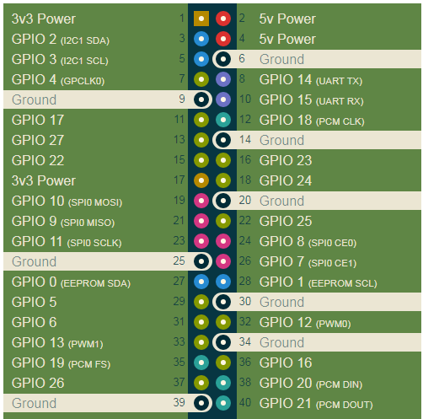
UART Verification
Test Case Laptop/Tablet
Raspberry Pi 1 GPIO
Libraries to include: WiringPi
Raspberry Pi 2 GPIO

Slide 5
SparkFun Qwiic MicroPressure Sensor
GND
3V3
SCL
SDA
RESET
EOC
Pressure Sensor Verification
Raspberry Pi 1 GPIO
Libraries to include: WiringPi Adafruit_MPRLS
cmath

Slide 6
500 Ω Potentiometer
500 Ω Potentiometer
Potentiometer Input Verification
Raspberry Pi 1 GPIO
Libraries to include: WiringPi Adafruit_MPRLS
cmath

Slide 7
Test Case Laptop/Tablet
100 Ω Resistor
100 Ω Resistor
Overspeed LED
Excessive Manoeuvre LED
Raspberry Pi 1 GPIO
Raspberry Pi 2 GPIO
Vertical Acceleration LED
100 Ω Resistor
LED Verification
Libraries to include: WiringPi Adafruit_MPRLS
cmath

Slide 8
GND
VCC
SDA
SCL
1602 I2C Module
VAC Limit Display (Optional)
Libraries to include: WiringPi Adafruit_MPRLS
cmath
Display Verification

Slide 9
SparkFun Qwiic MicroPressure Sensor
GND
3V3
SCL
SDA
RESET
EOC
500 Ω Potentiometer
(Pstatic Input)
500 Ω Potentiometer (Rho Input)
Test Case Laptop/Tablet
500 Ω Potentiometer (Weight Input)
100 Ω Resistor
Overspeed LED
100 Ω Resistor
Excessive Manoeuvre LED
Raspberry Pi 1 GPIO
Raspberry Pi 2 GPIO
Vertical Acceleration LED
GND
VCC
SDA
SCL
GND
VCC
SDA
SCL
100 Ω Resistor
1602 I2C Module
1602 I2C Module
500 Ω Potentiometer (Flap Input)
500 Ω Potentiometer
(VAC Input)
Airspeed Display
VAC Limit Display (Optional)
Libraries to include: WiringPi Adafruit_MPRLS
cmath
Full Setup

Slide 10
Pitot Pressure (Syringe, via sensor)
Module 1 Airspeed Indicator
Indicated Airspeed (Console Output)
Static Pressure (Potentiometer)
Airspeed Warning (Console + LED)
Air Density (Potentiometer)
Flap Position (Potentiometer)
Module 2 Excessive Manoeuvre Warning
A/C Gross Weight (Potentiometer)
Vert. Acceleration Warning (Console + LED)
Vert. Acceleration (Potentiometer)
Manoeuvre Warning (Console + LED)

